Slide 1
Clinker Cooler Air Distribution Solution
Technical Development Program SPREAD 2016

Slide 2
Air Distribution Clinker Cooler
Cooling air measurements have been made
Using the Cooler Assessment Tool, evaluate the data and assess the clinker cooler operation
Use the “Guidelines and hints” tab
What are your main findings?
For each finding, what is the possible effect on operation?
What are your recommendations?
Assess the cooling air distribution. How can you improve?

Slide 3
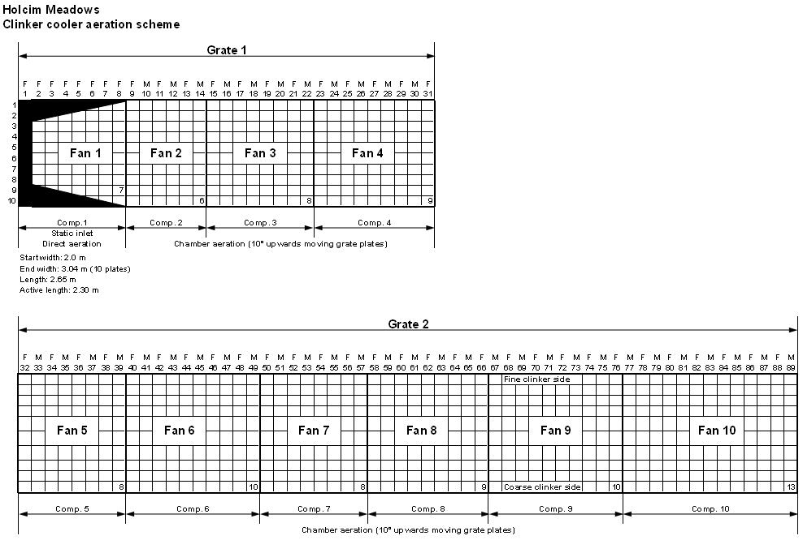
Cooler Aeration Scheme

Slide 4
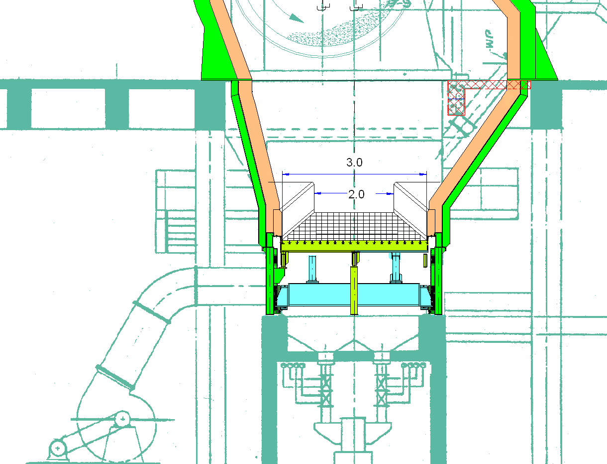
Cooler static inlet with horseshoe

Slide 5
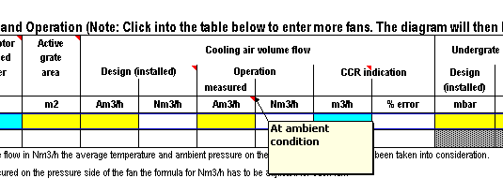
A Closer Look - Clinker Cooler Air Distribution
All measured data should be converted to ambient conditions at the fan inlet side

Slide 6
Specific Task
The flow of fan 7 has been measured in the duct between the fan and cooler side wall: 31’339 Am3/h at 32°C
Convert this air flow to ambient conditions at the fan inlet

Slide 7
Solution
The flow of fan 7 has been measured in the duct between the fan and cooler side wall: 31’339 Am3/h at 32°C
Convert this air flow to ambient conditions at the fan inlet

Slide 8
Main Findings
Main findings
Air flow profile: High flow behind static inlet ➔ negative impact on heat recuperation
Undergrate pressure profile: Flat pressure profile behind static inlet ➔ unsealed compartments
Specific cooler area load: 47.2 t/d/m² (slightly on high side)
Specific grate width load: 1’326 t/d/m (in normal range)
Installed cooling air volume: 2.209 Nm³/kg_{cli} (in normal range)
Specific cooling air in operation: 1.984 Nm³/kg_{cli} (in normal range)
Clinker bed height: 450 mm on 1st grate Clinker bed height calculation matches with under grate pressure behind the static inlet (44 mbar)
Clinker temperature drop on static inlet: 319°C ➔ Split required (see next slide)
Clinker temperature drop of compartment 2 too high due to too high air flow. ➔ Reduce air flow when compartments are sealed!
Calibration required for fans 1, 2 and 6
Expected operational problems
High clinker temperature 160°C due to too low clinker bed
Unsealed compartments: Air losses into cold clinker areas
Reduced cooler efficiency

Slide 9
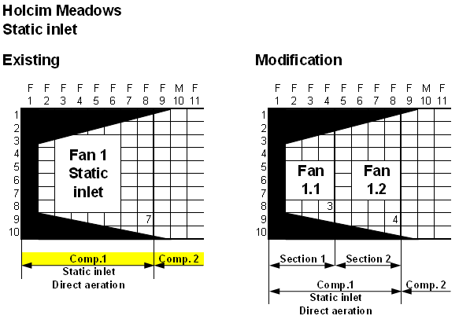
Split static inlet

